Slide 1

Unit-3 Servlet API and Overview
Advanced java Programming
GTU #3160707
Prof. Jayesh D. Vagadiya
Computer Engineering Department
Jayesh.vagadiya@darshan.ac.in
9537133260

Slide 2
Subject Overview
Sr. No. | Unit | % Weightage
1 | Java Networking | 5
2 | JDBC Programming | 10
3 | Servlet API and Overview | 25
4 | Java Server Pages | 25
5 | Java Server Faces | 10
6 | Hibernate | 15
7 | Java Web Frameworks: Spring MVC | 10
Reference Book:
Professional Java Server Programming by Subrahmanyam Allamaraju, Cedric Buest Wiley Publication

Slide 3


What is Servlet?
Servlet is java class which extends the functionality of web server by dynamically generating web pages.
Servlet: Basic Terms
Before looking into Servlet, we will see some important keywords about web application.
Web Client: We will call browsers (IE, Chrome, Mozilla etc.) as a Client, which helps in communicating with the server
Http Request
Server and Client (browser) will communicate with each other with the help of HTTP protocol.
Web Server is the one which takes the client request, process the request and sends back the response.
Server
Client
Http Response

Slide 4
Introduction
Servlet technology is used to create Dynamic web application
Servlet technology is robust and scalable .
Before Servlet, CGI (Common Gateway Interface) scripting language was popular as a server-side programming language, but there were many disadvantages of this technology.
Changes with respect to time
To retrive server’s current DATE and Time
News paper clippings
Online Shopping
e.g. Virtual Dressing Room
..
.

Slide 5




Why we need Servlet?
Nowadays everything is available on Internet.
Starting from e-banking, e-commerce everything is available through internet. We call all these applications as Web applications.
Hey Server, I want to display given name in my web page
Sorry, I can’t do that Dynamic computation
Hi, I am Servlet.
Let me help you to display given name in your web page.
But I have an application named SERVLET, which can process your request
Client
Server
Dynamic Response

Slide 6
Scripting Language
Server-Side
Scripting Language
Client-Side
Scripting Language
PHP ASP.NET (C# OR Visual Basic) C++ Java and JSP Python Ruby on Rails etc. | JavaScript VBScript HTML (Structure) CSS (Designing) AJAX jQuery etc.
Server-side scripting is often used to provide a customized interface for the user.
Client-side scripting is an important part of the Dynamic HTML. Usually run on client’s browser.

Slide 7
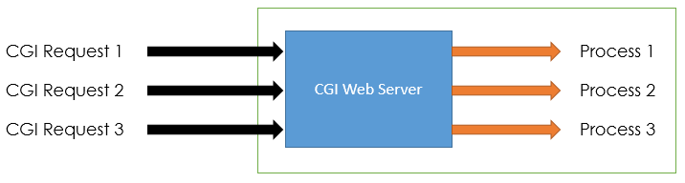
CGI (Common Gateway Interface)
CGI was the 1st server-side scripting technique for creating dynamic content.
CGI is used to execute a program that resides in the server to process data or access databases to produce the relevant dynamic content.
For each request CGI Server receives, It creates new Operating System Process.
If the number of requests from the client increases then more time it will take to respond to the request.
As programs executed by CGI Script are written in the native languages such as C, C++, perl which are not portable.

Slide 8
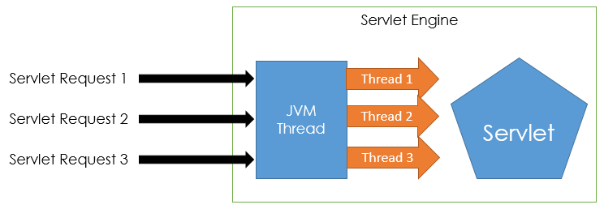
Comparing Servlet with CGI
CGI programs are used to execute programs written inside the native language.
While in Servlet, all the programs are compiled into the Java bytecode, which is then run in the Java virtual machine.
In Servlet, all the requests coming from the Client are processed with the threads instead of the OS process.
Image Reference:http://www.c4learn.com/java/servlet/servlet-vs-cgi/

Slide 9
Summary: CGI vs Servlet
CGI | Servlet
CGI was not portable. | Servlets are portable.
In CGI each request is handled by heavy weight OS process. | In Servlets each request is handled by lightweight Java Thread.
Session tracking and caching of previous computations cannot be performed. | Session tracking and caching of previous computations can be performed
CGI cannot handle cookies. | Servlets can handle cookies.
CGI does not provide sharing property. | Servlets can share data among each other.
CGI is more expensive than Servlets | Servlets is inexpensive than CGI.

Slide 10
Servlet Packages
Servlet interface needs to be implemented for creating any servlet. It provides 3 life cycle methods.
Package javax.servlet
Interface
Servlet
Implemented by
It provides implementation of methods of Servlet interfaces.
GenericServlet
extended by
Contains interface and abstract class for servlet that understands HTTP protocol.
Package: javax.servlet.http
Class
HttpServlet
extended by
MyServlet
User defined Servlet class.

Slide 11
Servlet Life Cycle
init()
Servlet
In Service
destroy()
Servlet class is loaded.
Servlet instance is created.
init() method is invoked.
service()
Servlet Container

Slide 12
Servlet Life Cycle: init()
Servlet class is loaded
The classloader is responsible to load the servlet class. The servlet class is loaded when the first request for the servlet is received by the web container.
Servlet instance is created
The web container creates the instance of a servlet after loading the servlet class. The servlet instance is created only once in the servlet life cycle.
Init() method is invoked
The web container calls the init method only once after creating the servlet instance. The init method is used to initialize the servlet.
Syntax
public void init(ServletConfig config) throws ServletException
{
//initialization…
}
A servlet configuration object used by a servlet container to pass information to a servlet during initialization process.

Slide 13
Servlet Life Cycle: Service()
The service() method is the main method to perform the actual task.
The servlet container (i.e. web server) calls the service() method to handle requests coming from the client( browsers) and to write the response back to the client.
Each time the server receives a request for a servlet, the server spawns a new thread and calls service.
The service() method checks the HTTP request type (GET, POST, PUT, DELETE, etc.) and calls doGet, doPost, doPut, doDelete, etc. methods as appropriate.
The doGet() and doPost() are most frequently used methods with in each service request.
Syntax
public void service(ServletRequest request, ServletResponse response)
throws ServletException, IOException
{
…
}

Slide 14
Servlet Life Cycle: Destroy()
The destroy() method is called only once at the end of the life cycle of a servlet.
This method gives your servlet a chance to close
database connections,
halt background threads,
write cookie lists or hit counts to disk, and
perform other such cleanup activities.
After the destroy() method is called, the servlet object is marked for garbage collection.
Syntax
public void destroy()
{
// Finalization code...
}

Slide 15
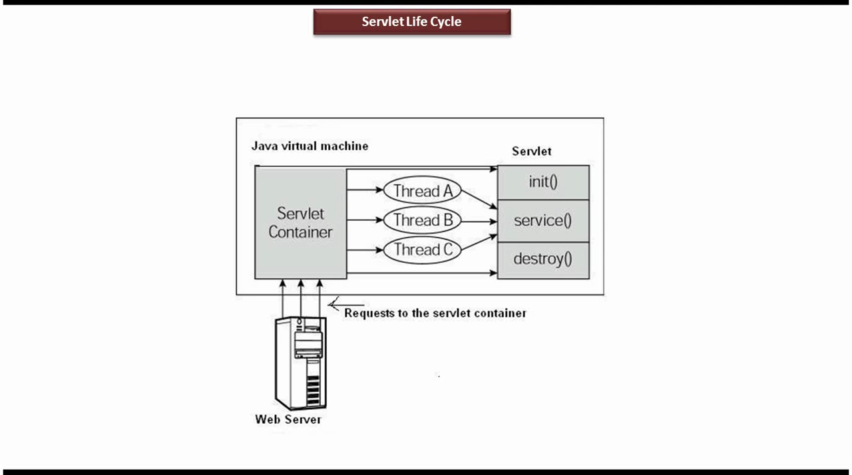
Servlet Life Cycle

Slide 16
doGet() v/s doPost()
doGet()
A GET request results from request for a URL or from an HTML form, should be handled by doGet() method.
doPost()
A POST request results from an HTML form that specifically lists POST as the METHOD and it should be handled by doPost() method.
Syntax
public void doGet(HttpServletRequest request,HttpServletResponse response)
throws ServletException, IOException
{
// Servlet code …
}
Syntax
public void doGet(HttpServletRequest request,HttpServletResponse response) throws ServletException, IOException
{
// Servlet code …
}

Slide 17
doGet() vs doPost()
doGet() | doPost()
In this method, parameters are appended to the URL and sent along with header information | In doPost(), parameters are sent in separate line in the body
Maximum size of data that can be sent using doGet() is 240 bytes | There is no maximum size for data
Parameters are not encrypted | Parameters are encrypted here
Application: Used when small amount of insensitive data like a query has to be sent as a request. It is default method. | Application: Used when comparatively large amount of sensitive data has to be sent. E.g. submitting sign_in or login form.
doGet() is faster comparatively | doPost() is slower compared to doGet() since doPost() does not write the content length

Slide 18
Servlet Life Cycle: Servlet Code
MyServlet.Java
1
2
3
4
5
6
7
8
9
10
11
12
13
14
15
16
17
18
import java.io.*;
import javax.servlet.*;
public class MyServlet1 extends GenericServlet
{
public void init() throws ServletException
{//Initailization Code
}
public void service(ServletRequest request,ServletResponse response) throws ServletException,IOException
{//Servlet code
}
public void destroy()
{//Finalization Code
}
}

Slide 19
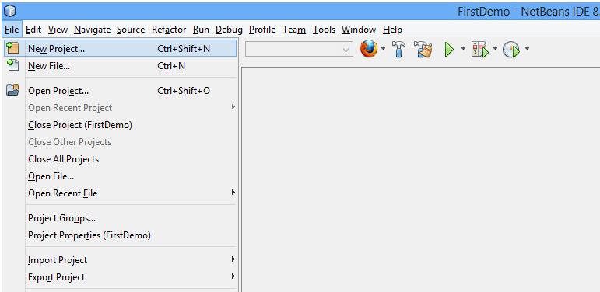
Steps to run Servlet Program in Netbeans
Step 1: Open Netbeans IDE, Select File -> New Project

Slide 20
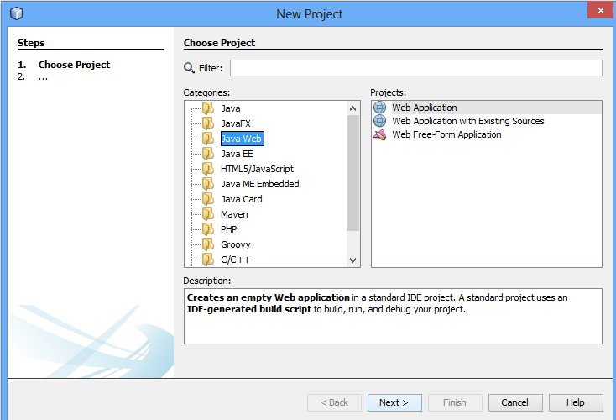
Steps for Servlet Program
Step 2: Select Java Web -> Web Application, then click on Next

Slide 21
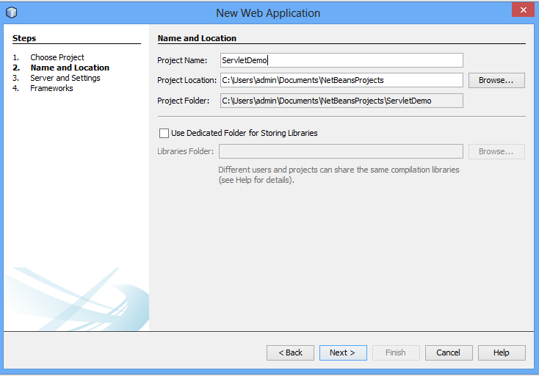
Steps for Servlet Program
Step 3: Give a name to your project and click on Next,

Slide 22
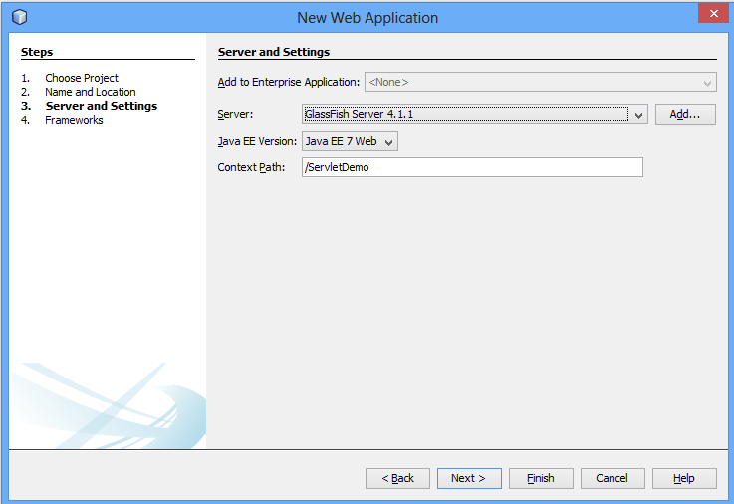
Steps for Servlet Program
Step 4: and then, Click Finish

Slide 23
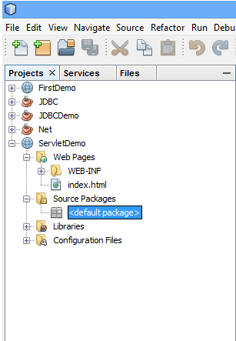
Steps for Servlet Program
Step 5: The complete directory structure required for the Servlet Application will be created automatically by the IDE.

Slide 24
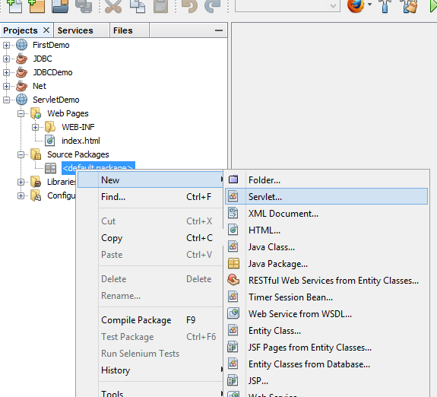
Steps for Servlet Program
Step 6: To create a Servlet, open Source Package, right click on default packages -> New -> Servlet.

Slide 25
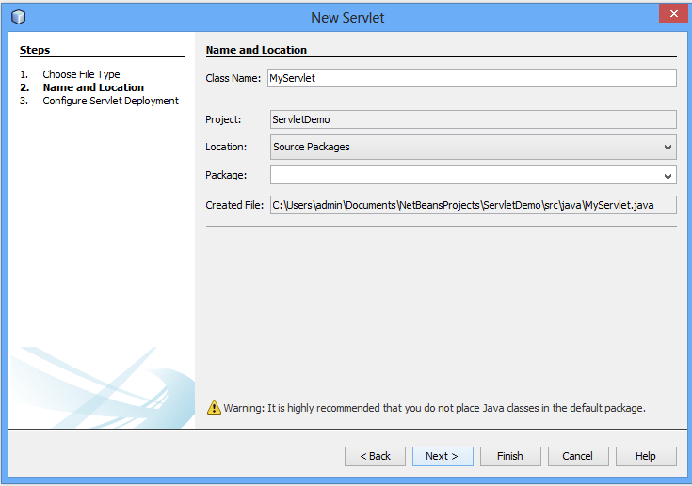
Steps for Servlet Program
Step 7: Give a Name to your Servlet class file

Slide 26
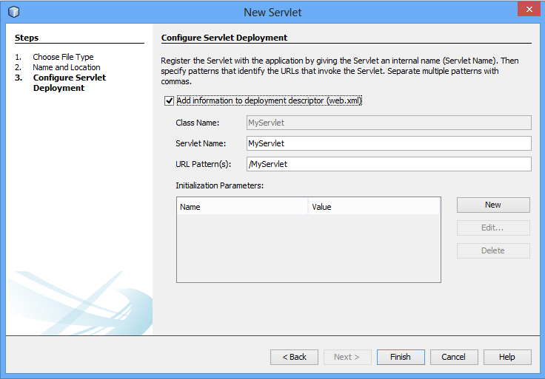
Steps for Servlet Program
Web.xml is the configuration file of web applications in java.
It will add servlet information to web.xml file

Slide 27
Step 8: Write servlet code: MyServlet.java
MyServet1.java
1
2
3
4
5
6
7
8
9
10
11
12
13
14
15
16
17
18
19
20
21
22
23
24
import java.io.*;
import javax.servlet.*;
import javax.servlet.http.*;
public class MyServlet1 extends HttpServlet
{ String msg="";
PrintWriter out;
public void init() throws ServletException
{ msg="hello world: my first servlet program"; }
public void doGet(HttpServletRequest request, HttpServletResponse response)throws ServletException,IOException
{
response.setContentType("text/html");
out=response.getWriter();
out.println(msg);
}
public void destroy()
{ out.close();
}
}

Slide 28
MIME: Multipurpose Internet Mail Extensions
A MIME type nomenclature includes a type and subtype separated by a forward slash.
It is a HTTP header that provides the description about what are you sending to the browser.
text/html
text/plain
text/css
text/richtext
application/msword
application/jar
application/pdf
images/jpeg images/png images/gif
audio/mp3
video/mp4
MIME is a standard set to Internet to notify the format of the file contents.

Slide 29
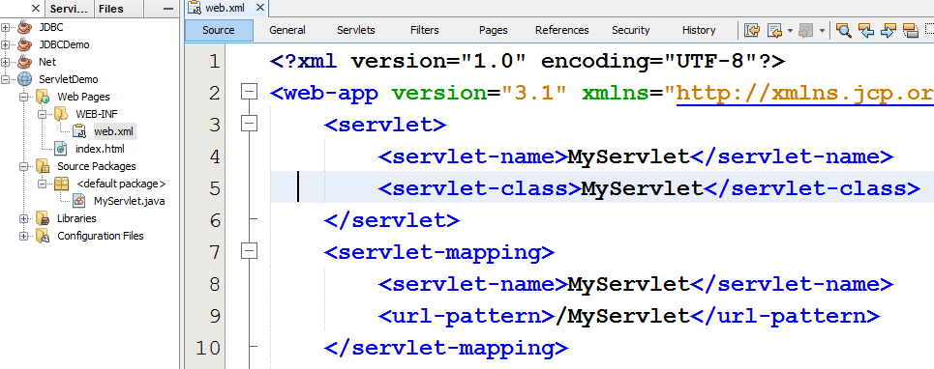
Steps for Servlet Program
Step 9: open web.xml
Configuration of servlet using <servlet>
It is used to map Servlet to specific URL
Map the servlet to a URL. This can be done using <servlet-mapping> element.

Slide 30
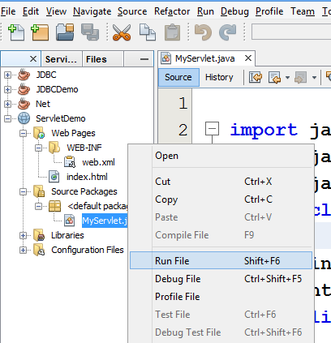
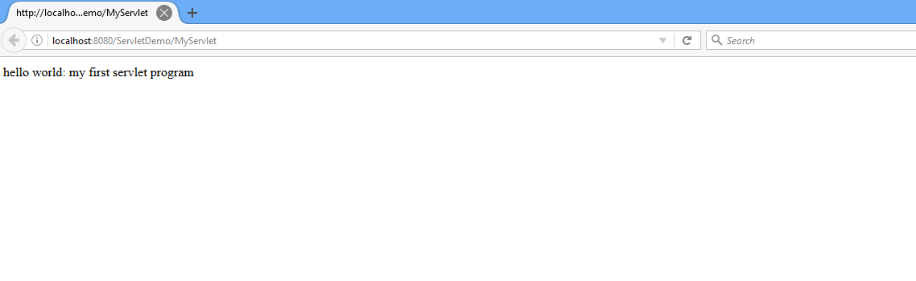
Steps for Servlet Program
Step 11: Run your application, right click on your Project and select Run

Slide 31
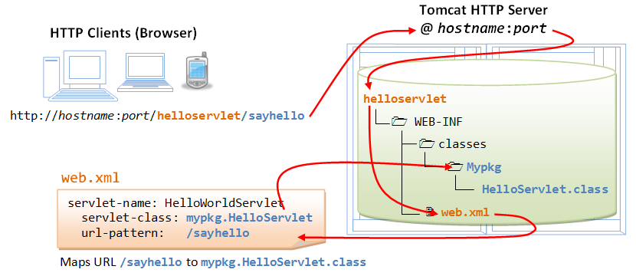
Java Servlet
1
2
5
3
4
Ref: https://www.ntu.edu.sg/home/ehchua/programming/java/JavaServlets.html

Slide 32
javax.servlet Interface
It is used to get configuration information from web.xml file. If the configuration information is modified from the web.xml file, we don't need to change the servlet.
Javax.servlet
ServletConfig
ServletContext
It provides an interface between the container and servlet. It is global to entire web application
ServletRequest
It is used to provide the client request information to a servlet such as content type, content length, parameter names and values, header informations, attributes
ServletResponse
It contains various methods that enable a servlet to respond to the client requests. A servlet can send the response either as character or binary data.

Slide 33
Types of Servlet
Generic Servlet
javax.servlet (package)
extends javax.servlet.Servlet
service method
service(ServletRequest req, ServletResponse res)
Http Servlet
javax.servlet.http (package)
extends javax.servlet.HttpServlet
doGet(), doPost()
doGet(HttpServletRequest req,HttpServletResponse res)
doPost(HttpServletRequest req,HttpServletResponse res)

Slide 34
GenericServlet vs HttpServlet
GenericServlet | HttpServlet
javax.servlet.GenericServlet | javax.servlet.http.HttpServlet
It defines a generic, protocol-independent servlet. | It defines a HTTP protocol specific servlet.
GenericServlet is a super class of HttpServlet class. | HttpServlet is a sub class of GenericServlet class.
Can handle all types of protocols | only HTTP specific protocols.
It supports only one abstract method:service() | It support doGet(), doPost() etc.

Slide 35
Deployment Descriptor
Located @ WEB-INF directory
File known as web.xml
It controls the behavior of Java Servlet
What does it contain?
XML Header
DOCTYPE
Web-app element
The Web-app element should contain a servlet element with 3 sub-element.
<servlet-name>: name used to access java servlet
<servlet-class>: class name of java servlet
<init-param>: for initialization parameter

Slide 36
Deployment Descriptor: web.xml
<?xml version="1.0" encoding="UTF-8"?>
<!DOCTYPE web-app
PUBLIC "-//Sun Microsystems, Inc.//DTD Web Application 2.3//EN"
"http://java.sun.com/dtd/web-app_2_3.dtd">
<web-app>
<servlet>
<servlet-name>MyServlet</servlet-name>
<servlet-class>MyServlet</servlet-class>
<init-param>
<param-name>name</param-name>
<param-value>cxcy</param-value>
</init-param>
</servlet>
<servlet-mapping>
<servlet-name>MyServlet</servlet-name>
<url-pattern>/MyServlet</url-pattern>
</servlet-mapping>
</web-app>
xml header
Document Type Definition
Configures a web application.
Name used to access Java Servlet
Name of servlet .java class
Used to pass parameters to a servlet from the web.xml file.
map the servlet to a URL or URL pattern
Controls behavior of Servlet

Slide 37
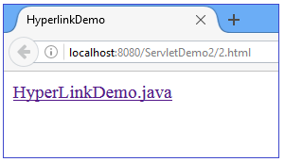
Program to call servlet from html file
Write a java Servlet program to call servlet from html hyperlink.
2.html
1
2
3
4
5
6
7
8
<html>
<head>
<title> HyperLinkDemo </title>
</head>
<body>
<a href ="/ServletDemo2/HyperLinkDemo">HyperLinkDemo.java </a>
</body>
</html>

Slide 38
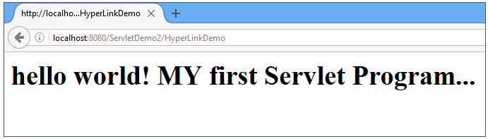
Servlet Program: HyperLinkDemo.java
HyperLinkDemo.java
1
2
3
4
5
6
7
8
9
10
11
12
13
14
15
16
17
18
19
import javax.servlet.*;
import javax.servlet.http.*;
import java.io.*;
public class HyperLinkDemo extends HttpServlet
{ String msg="";
PrintWriter out;
public void init(ServletConfig config)throws ServletException
{ msg="hello world! MY first Servlet Program...";
}
public void doGet(HttpServletRequest request,HttpServletResponse response) throws ServletException,IOException
{ response.setContentType("text/html");
out=response.getWriter();
out.println("<h1>"+msg+"</h1>");
}
public void destroy()
{ out.close();
}
}

Slide 39
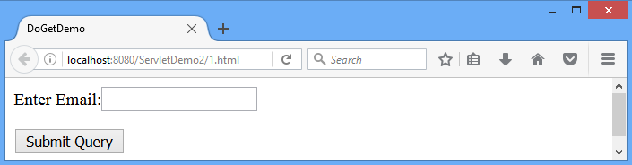
doGet()
1.html
1
2
3
4
5
6
7
8
9
10
11
<html>
<head>
<title> DoGetDemo </title>
</head>
<body>
<form action="/ServletDemo2/DoGetDemo">
Enter Email:<input type="text" name="email">
<p><input type="submit"></p>
</form>
</body>
</html>

Slide 40
doGet()
DoGetDemo.java
1
2
3
4
5
6
7
8
9
10
11
12
13
14
15
16
17
18
19
20
import javax.servlet.*;
import javax.servlet.http.*;
import java.io.*;
public class DoGetDemo extends HttpServlet
{ PrintWriter out;
public void init(ServletConfig config)throws ServletException
{
}
public void doGet(HttpServletRequest request,HttpServletResponse response)throws ServletException,IOException
{
String email=request.getParameter("email");
response.setContentType("text/html");
out =response.getWriter();
out.println("my email:"+email);
}
public void destroy()
{ out.close();
}
}
String getParameter(String name)
Returns the value of a request parameter as a String

Slide 41
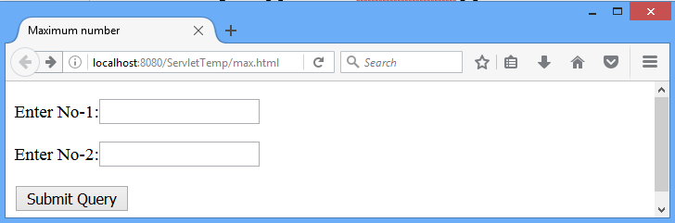
doPost()
Write a Servlet program to enter two numbers and find maximum among them.
max.html
1
2
3
4
5
6
7
8
9
10
11
12
13
<!DOCTYPE html>
<html>
<head>
<title> Maximum number </title>
</head>
<body>
<form action="/ServletTemp/Max" method="POST" >
<p>Enter No-1:<input type="text" name="no1"></p>
<p>Enter No-2:<input type="text" name="no2"></p>
<p><input type="submit"></p>
</form>
</body>
</html>

Slide 42
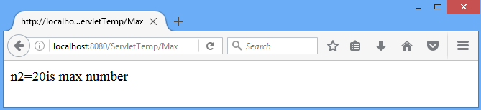
doPost()
Max.java
1
2
3
4
5
6
7
8
9
10
11
12
13
14
15
16
17
18
19
20
import java.io.*;
import javax.servlet.*;
import javax.servlet.http.*;
public class Max extends HttpServlet
{
public void doPost(HttpServletRequest request, HttpServletResponse response)throws ServletException,IOException
{ int n1=0,n2=0;
response.setContentType("text/html");
PrintWriter out=response.getWriter();
n1=Integer.parseInt(request.getParameter("no1"));
n2=Integer.parseInt(request.getParameter("no2"));
if(n1>n2)
out.println("n1="+n1+"is max number");
else if(n2>n1)
out.println("n2="+n2+"is max number");
else if(n1==n2)
out.println("n1= "+n1+"and n2= "+n2+"are equal numbers");
}
}
Using doPost()

Slide 43
ServletConfig Interface
It is used to get configuration information from web.xml file.
If the configuration information is modified from the web.xml file, we don't need to change the servlet.
Method :
String getInitParameter(String name) | Returns the parameter value for the specified parameter name.
Example
String str = config.getInitParameter("name")
web.xml
<init-param>
<param-name>name</param-name>

Slide 44
Servlet Config: web.xml
<web-app>
<servlet>
<servlet-name>MyServlet</servlet-name>
<servlet-class>MyServlet</servlet-class>
<init-param>
<param-name>name</param-name>
<param-value>cxcy</param-value>
</init-param>
</servlet>
<servlet-mapping>
<servlet-name>MyServlet</servlet-name>
<url-pattern>/MyServlet</url-pattern>
</servlet-mapping>
</web-app>

Slide 45
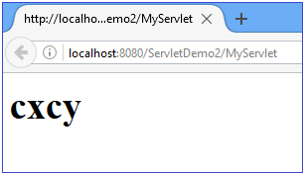
Servlet Config: MyServlet.java
MyServlet.java
1
2
3
4
5
6
7
8
9
10
11
12
13
14
15
16
17
18
19
20
import javax.servlet.*;
import javax.servlet.http.*;
import java.io.*;
public class MyServlet extends HttpServlet
{ String msg;
PrintWriter out;
public void init(ServletConfig config)throws ServletException
{
msg = config.getInitParameter("name");
}
public void doGet(HttpServletRequest request , HttpServletResponse response) throws
ServletException,IOException
{ response.setContentType("text/html");
out = response.getWriter();
out.println("<h1>"+ msg +"</h1>");
}
public void destroy()
{ out.close();
}
}
<param-value>

Slide 46
ServletContext Interface
ServletContext is created by the web container at time of deploying the project.
It can be used to get configuration information from web.xml file.
There is only one ServletContext object per web application.
If any information is shared to many servlet, it is better to provide it from the web.xml file using the <context-param> element.
<web-app>
...
<context-param>
<param-name>parametername</param-name>
<param-value>parametervalue</param-value>
</context-param>
...
<servlet>
...
</servlet>
</web-app>
used to define initialization parameter in the application scope.

Slide 47
web.xml
<?xml version="1.0" encoding="UTF-8"?>
<web-app>
<servlet>
<servlet-name>ServletContextDemo</servlet-name>
<servlet-class>ServletContextDemo</servlet-class>
</servlet>
<servlet-mapping>
<servlet-name>ServletContextDemo</servlet-name>
<url-pattern>/ServletContextDemo</url-pattern>
</servlet-mapping>
<context-param>
<param-name>name</param-name>
<param-value>DIET</param-value>
</context-param>
</web-app>

Slide 48
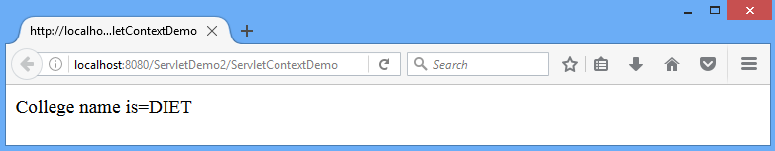
ServletContextDemo.java
ServletContextDemo.java
1
2
3
4
5
6
7
8
9
10
11
12
13
14
15
16
17
import java.io.*;
import javax.servlet.*;
import javax.servlet.http.*;
public class ServletContextDemo extends HttpServlet
{
public void doGet(HttpServletRequest req,HttpServletResponse res) throws ServletException,IOException
{ res.setContentType("text/html");
PrintWriter out=res.getWriter();
//creating ServletContext object
ServletContext context=getServletContext();
//Getting the value of the initialization parameter and printing it
String college=context.getInitParameter("name");
out.println("College name is="+college);
out.close();
}
}

Slide 49
Servlet Config vs Servlet Context
Servlet Config | Servlet Context
ServletConfig object is one per servlet class | ServletContext object is global to entire web application
Object of ServletConfig will be created during initialization process of the servlet | Object of ServletContext will be created at the time of web application deployment
Scope: As long as a servlet is executing, ServletConfig object will be available, it will be destroyed once the servlet execution is completed. | Scope: As long as web application is executing, ServletContext object will be available, and it will be destroyed once the application is removed from the server.
We should give request explicitly, in order to create ServletConfig object for the first time | ServletContext object will be available even before giving the first request
In web.xml – <init-param> tag will be appear under <servlet-class> tag | In web.xml – <context-param> tag will be appear under <web-app> tag

Slide 50
HttpServletRequest: Methods
String getContextPath() | Returns the portion of the request URI that indicates the context of the request.
Enumeration getHeaderNames() | Returns an enumeration of all the header names this request contains.
String getHeader(String name) | Returns the value of the specified request header as a String.
String getQueryString() | Returns the query string that is contained in the request URL after the path.
String getServletPath() | Returns the part of this request's URL that calls the servlet. This path starts with a "/" character and includes either the servlet name or a path to the servlet
String getMethod() | Returns the name of the HTTP method with which this request was made, for example GET or POST

Slide 51
HttpServletRequest: Methods
String getContextPath() | Returns the portion of the request URI that indicates the context of the request.
getContextPath
1
2
3
4
public void doGet(HttpServletRequest request, HttpServletResponse response)
{
out.println("<p>request.getContextPath():" +request.getContextPath()+"</p>");
}
Output
request.getContextPath():/ServletTemp

Slide 52
HttpServletRequest: Methods
Enumeration getHeaderNames() | Returns an enumeration of all the header names this request contains.
getHeaderNames
1
2
3
4
5
6
7
8
9
10
11
public void doGet(HttpServletRequest request,HttpServletResponse response)
{
Enumeration h=request.getHeaderNames();
while(h.hasMoreElements())
{
String paramName = (String)h.nextElement();
out.print("<p>" + paramName + "\t");
String paramValue = request.getHeader(paramName);
out.println( paramValue + "</p>\n");
}
}
Output
host localhost:8080
user-agent Mozilla/5.0 (Windows NT 6.2; WOW64;rv:50.0) Gecko/20100101 Firefox/50.0
accept text/html,application/xhtml+xml,application/xml;q=0.9,*/*;q=0.8
accept-language en-US,en;q=0.5
accept-encoding gzip, deflate
connection keep-alive
upgrade-insecure-requests 1

Slide 53
HttpServletRequest: Methods
String getHeader(String name) | Returns the value of the specified request header as a String.
getHeader
1
2
3
4
5
public void doGet(HttpServletRequest request,HttpServletResponse response)
{
out.println("<p>request.getHeader(): " +request.getHeader("host")+"</p>");
out.println("<p>request.getHeader(): " +request.getHeader("referer")+"</p>");
}
Output
request.getHeader():host=localhost:8080
request.getHeader():referer=http://localhost:8080/ServletTemp/servletmeth.html

Slide 54
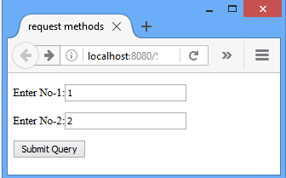
HttpServletRequest: Methods
String getQueryString() | Returns the query string that is contained in the request URL after the path.
getQueryString
1
2
3
4
5
public void doGet(HttpServletRequest request,HttpServletResponse response)
{
out.println("<p>request.getQueryString():" +request.getQueryString()+"</p>");
}
Output
requrest.getQueryString(): no1=1&no2=2

Slide 55
HttpServletRequest: Methods
String getServletPath() | Returns the part of this request's URL that calls the servlet. This path starts with a "/" character and includes either the servlet name or a path to the servlet
getServletPath
1
2
3
4
public void doGet(HttpServletRequest request, HttpServletResponse response)
{
out.println("<p>request.getServletPath():" +request.getServletPath()+"</p>");
}
Output
request.getServletPath(): /ServletMeth

Slide 56
HttpServletRequest: Methods
String getMethod() | Returns the name of the HTTP method with which this request was made, for example GET or POST
getServletPath
1
2
3
4
public void doGet(HttpServletRequest request, HttpServletResponse response)
{
out.println("<p>request.getMethod():"+request.getMethod()+"</p>");
}
Output
request.getMethod(): GET

Slide 57
javax.servlet.RequestDispatcher Interface
The RequestDispatcher interface provides the facility of dispatching the request to another resource.
Resource can be HTML, Servlet or JSP.
This interface can also be used to include the content of another resource.
It is one of the way of servlet collaboration.
void forward(ServletRequest request, ServletResponse response) throws ServletException, IOException | Forwards a request from a servlet to another resource (servlet, JSP file, or HTML file) on the server.
void include(ServletRequest request, ServletResponse response) throws ServletException, IOException | Includes the content of a resource (Servlet, JSP page, or HTML file) in the response.

Slide 58

RequestDispatcher: forward()
Step2: forward(req, res)
Servlet 1
Servlet 2
Step1: Request
Step 3:
Response is generated
Response
Web Client
Step 4: Response is sent back to browser
Response

Slide 59
RequestDispatcher: include()
Step2: include(req, res)
Servlet 1
Servlet 2
Step1: Request
Step3:
Response of Servlet 2 is included in the Response of Servlet 1
Response
Web Client
Response
Final Response is sent back to the client fron Servlet 1

Slide 60
How to get the object of RequestDispatcher?
The getRequestDispatcher() method of ServletRequest interface returns the object of RequestDispatcher.
Syntax
1
RequestDispatcher getRequestDispatcher(String resource)
Name of Servlet specified in <url-pattern>
Example
1
RequestDispatcher rd=request.getRequestDispatcher("servlet2");

Slide 61
RequestDispatcher: forward() and include()
Forward()
1
2
RequestDispatcher rd = request.getRequestDispatcher("servlet2");
rd.forward(request, response);
Forward()
1
2
RequestDispatcher rd = request.getRequestDispatcher("/1.html");
rd.forward(request, response);
Include()
1
2
RequestDispatcher rd = request.getRequestDispatcher("servlet2");
rd.include(request, response);
Include()
1
2
RequestDispatcher rd = request.getRequestDispatcher("/1.html");
rd.include(request, response);

Slide 62
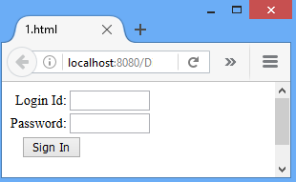
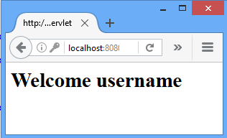
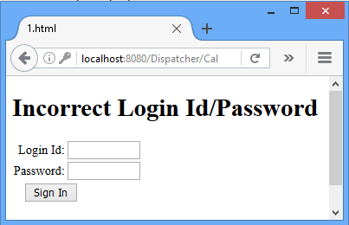
RequestDispatcher: Servlet Program
Validate Servlet
[CallServlet.java]
IsValid?
Yes
No
[include: 1.html]
[forward: FwdDemo.java]

Slide 63
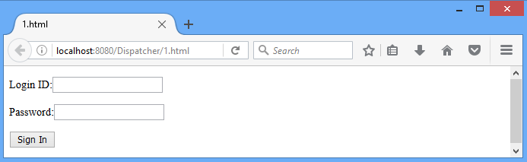
RequestDispatcher: 1.html
1.html
1
2
3
4
5
6
7
8
9
10
11
12
<html>
<head>
<title>1.html</title>
</head>
<body>
<form action="/Dispatcher/CallServlet” method="POST">
<p>Login ID:<input type="text" name="login"></p>
<p>Password:<input type="text" name="pwd"></p>
<p><input type="submit" value="Sign In"></p>
</form>
</body>
</html>

Slide 64
RequestDispatcher: Validate Servlet
callServlet.java
1
2
3
4
5
6
7
8
9
10
11
12
13
14
15
16
17
18
19
20
public class CallServlet extends HttpServlet
{
public void doPost(HttpServletRequest request, HttpServletResponse response)
throws ServletException,IOException
{ response.setContentType("text/html");
PrintWriter out=response.getWriter();
RequestDispatcher rd;
String login=request.getParameter("login");
String pwd=request.getParameter("pwd");
if(login.equals("java") && pwd.equals("servlet"))
{ rd=request.getRequestDispatcher("FwdDemo");
rd.forward(request, response);}//if
else
{ out.println("<p><h1>Incorrect Login Id/Password </h1></p>");
rd=request.getRequestDispatcher("/1.html");
rd.include(request, response);
}
}
//dopost
}

Slide 65
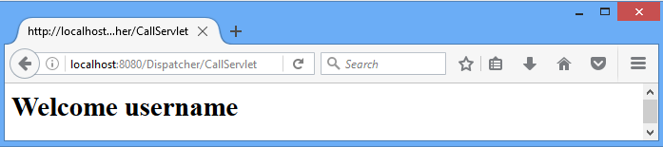
RequestDispatcher: fwdDemo.java
fwdDemo.java
1
2
3
4
5
6
7
8
9
10
11
12
13
import javax.servlet.*;
import javax.servlet.http.*;
import java.io.*;
public class FwdDemo extends HttpServlet{
public void doPost(HttpServletRequest request,HttpServletResponse response)
throws ServletException,IOException
{ response.setContentType("text/html");
PrintWriter out=response.getWriter();
String username=request.getParameter("login");
out.println("<h1>"+"Welcome "+username+"</h1>");
}
}

Slide 66
RequestDispatcher: web.xml
web.xml
1
2
3
4
5
6
7
8
9
10
11
12
13
14
15
16
17
18
19
<web-app>
<servlet>
<servlet-name>FwdDemo</servlet-name>
<servlet-class>FwdDemo</servlet-class>
</servlet>
<servlet>
<servlet-name>CallServlet</servlet-name>
<servlet-class>CallServlet</servlet-class>
</servlet>
<servlet-mapping>
<servlet-name>FwdDemo</servlet-name>
<url-pattern>/FwdDemo</url-pattern>
</servlet-mapping>
<servlet-mapping>
<servlet-name>CallServlet</servlet-name>
<url-pattern>/CallServlet</url-pattern>
</servlet-mapping>
</web-app>

Slide 67
SendRedirect
The sendRedirect() method of HttpServletResponse interface can be used to redirect response to another resource, it may be servlet, jsp or html file.
Syntax
1
void sendRedirect(String location) throws IOException
Example
1
2
3
response.sendRedirect("http://www.darshan.ac.in");
response.sendRedirect("/1.html");//relative path
response.sendRedirect("http://localhost:8080/1.html"); //absolute path

Slide 68
sendRedirect(): Example
Example
1
2
3
4
5
6
7
8
9
10
11
12
13
14
15
16
17
18
public class Redirect extends HttpServlet
{
public void doGet( HttpServletRequest request, HttpServletResponse response)
throws ServletException,IOException
{ response.setContentType("text/html");
PrintWriter out=response.getWriter();
String login=request.getParameter("login");
String pwd=request.getParameter("pwd");
if(login.equals("java") && pwd.equals("servlet"))
{
response.sendRedirect("/Dispatcher/Welcome");
}
else
{
response.sendRedirect("/Dispatcher/redirect.html");
}
} //doGet
}

Slide 69
forward() vs sendRedirect()
forward() | sendRedirect()
The forward() method works at server side. | The sendRedirect() method works at client side.
It sends the same request and response objects to another servlet. | It always sends a new request.
It can work within the server only. | It can be used within and outside the server.
original URL not change. | Here browser knows that it's making a new request, so original URL changes.
Example: request.getRequestD ispacher("servlet2").forward(request,response); | Example: response.sendRedirect("servlet2");

Slide 70
Session Management in Servlets
A session refers to the entire interaction between a client and a server from the time of the client’s first request,which generally begins the session, to the time of last request/response.
Why we require Session?
HTTP is a "stateless" protocol which means each time a client retrieves a Web page, the client opens a separate connection to the Web server and the server automatically does not keep any record of previous client request.
Session is required to keep track of users and their information.
When a User logs into your website, no matter on which web page he visits after logging in, his credentials will be with the server, until user logs out.
So this is managed by creating a session.
1. Request (New)
Client
Server
2. Response
3.Second Request (New)

Slide 71
Session Management
Session Management is a mechanism used by the Web container to store session information for a particular user.
There are four different techniques for session management.
Hidden form field
URL Rewriting
Session Management
Cookies
HttpSession

Slide 72
Session Management: Hidden form field
Hidden Form Field, a hidden (invisible) textfield is used for maintaining the state of an user.
In such case, we store the information in the hidden field and get it from another servlet.
Example
1
<input type="hidden" name="session_id" value="054">

Slide 73
Session Management: Hidden form field
login.html
Valid.java
Name:
Password:
Session_ID:
request.getParameter(“name”);
request.getParameter(“password”);
request.getParameter(“session”);
Hidden Field
`
054
Submit
Welcome.java
request.getParameter(“session”);

Slide 74
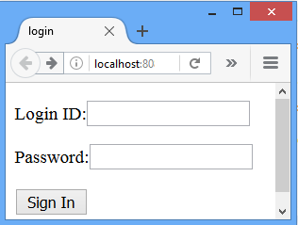
Session Management: Hidden form field
login.html
1
2
3
4
5
6
7
8
9
10
11
12
13
<html>
<head>
<title>login</title>
</head>
<body>
<form action="/Session/Valid" method="POST">
<p>Login ID:<input type="text" name="login"></p>
<p>Password:<input type="text" name="pwd"></p>
<p><input type="hidden" name="session_id" value="054"></p>
<p><input type="submit" value="Sign In"></p>
</form>
</body>
</html>

Slide 75
Session Management: Hidden form field
Valid.java
1
2
3
4
5
6
7
8
9
10
11
12
13
14
15
16
17
18
19
20
21
22
23
public class Valid extends HttpServlet
{ public void doPost(HttpServletRequest request, HttpServletResponse response) throws ServletException,IOException
{
response.setContentType("text/html");
PrintWriter out=response.getWriter();
RequestDispatcher rd;
String login=request.getParameter("login");
String pwd=request.getParameter("pwd");
String session=request.getParameter("session_id");
if(login.equals("java") && pwd.equals("servlet"))
{
rd=request.getRequestDispatcher("Welcome");
rd.forward(request, response);
}//if
else
{
out.println("<p><h1>Incorrect LoginId/Password </h1></p>");
rd=request.getRequestDispatcher("/login.html");
rd.include(request, response);
}//else
}
}
Hidden Field

Slide 76
Session Management: Hidden form field
Welcome.java
1
2
3
4
5
6
7
8
9
10
11
12
13
14
15
import javax.servlet.*;
import javax.servlet.http.*;
import java.io.*;
public class Welcome extends HttpServlet
{ public void doPost(HttpServletRequest request, HttpServletResponse response)
throws ServletException,IOException
{ response.setContentType("text/html");
PrintWriter out=response.getWriter();
String session=request.getParameter("session_id");
String username=request.getParameter("login");
out.println("<h1>"+"id:"+session+"</h1>");
out.println("<h3>"+"Welcome "+username+"</h3>");
}
}

Slide 77
Session Management: Hidden form field
Real application of hidden form field
It is widely used in comment form of a website.
In such case, we store page id or page name in the hidden field so that each page can be uniquely identified.
Advantage of Hidden Form Field
Easy to implement
It will always work whether cookie is disabled or not.
Disadvantage of Hidden Form Field
It is maintained at server side.
Extra form submission is required on each pages.
Only textual information can be used.
It does not support hyperlink submission.
Security
Hidden field will be visible with GET method
User might view page source and can view hidden field

Slide 78
Session Management: URL Rewriting
In URL rewriting, a token or identifier is appended to the URL of the next Servlet or the next resource.
We can send parameter name/value pairs using the following format:
URL ? Name1 = value1 & name2 = value2 &…
When the user clicks the hyperlink, the parameter name/value pairs will be passed to the server.
From a Servlet, we can use getParameter() method to obtain a parameter value.
A name and a value is separated using an equal (=) sign
name/value pair is separated from another parameter using the ampersand(&)

Slide 79
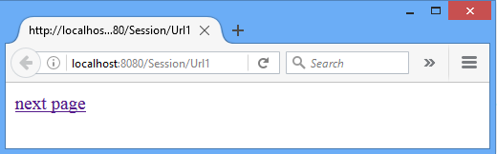
Session Management: URL Rewriting
Url1.java
1
2
3
4
5
6
7
8
9
10
11
12
13
14
15
16
import javax.servlet.*;
import javax.servlet.http.*;
import java.io.*;
public class Url1 extends HttpServlet
{
public void doGet(HttpServletRequest request, HttpServletResponse response)
throws ServletException,IOException
{
String url;
response.setContentType("text/html");
PrintWriter out=response.getWriter();
//for URL rewriting
url= "http://localhost:8080/Session/Url2?s_id1=054&s_id2=055";
out.println("<a href="+url+">next page</a>");
}
}

Slide 80
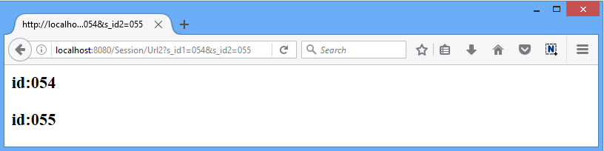
Session Management: URL Rewriting
Url2.java
1
2
3
4
5
6
7
8
9
10
11
12
13
14
15
import javax.servlet.*;
import javax.servlet.http.*;
import java.io.*;
public class Url2 extends HttpServlet
{ public void doGet(HttpServletRequest request, HttpServletResponse response)
throws ServletException,IOException
{ response.setContentType("text/html");
PrintWriter out=response.getWriter();
String session1=request.getParameter("s_id1");
String session2=request.getParameter("s_id2");
out.println("<h3>"+"id:"+session1+"</h3>");
out.println("<h3>"+"id:"+session2+"</h3>");
}
}

Slide 81
Session Management: URL Rewriting
Advantage of URL Rewriting
It will always work whether cookie is disabled or not (browser independent).
Extra form submission is not required on each pages.
Disadvantage of URL Rewriting
It will work only with links.
It can send only textual information.
URL header size constraint.
Security
name/value field will be visible with URL followed by ‘?’.

Slide 82
Session Management: Cookies
A cookie is a small piece of information that is persisted between the multiple client requests.
A cookie has a
Name
Single value
Optional attributes such as
comment
path
domain qualifiers
a maximum age
version number

Slide 83
Session Management: Cookies
By default, each request is considered as a new request
1. Request
Server will add cookie with response from the servlet
2. Response + Cookie
After that if request is sent by the user, cookie is added with request by default.
Thus, we recognize the user as the old user.
Web Client
So cookie is stored in the cache of the browser.
Server
3. Request + Cookie

Slide 84
Session Management: Cookies
Types of Cookie
Non-persistent cookie
Persistent cookie
It is valid for single session only.
It is removed each time when user closes the browser.
It is valid for multiple session .
It is not removed each time when user closes the browser.
It is removed only if user logout or signout.

Slide 85
Session Management: Cookies
Cookie class
javax.servlet.http.Cookie
This class provides the functionality of using cookies.
It provides a lots of useful methods for cookies.
Constructor
Cookie(String name, String value) | constructs a cookie with a specified name and value.
Example
1
Cookie c= new Cookie("session_id","054");

Slide 86
Session Management: Cookies : Methods
void setMaxAge(int expiry) | Sets the maximum age in seconds for this Cookie
int getMaxAge() | Gets the maximum age in seconds of this Cookie. By default, -1 is returned, which indicates that the cookie will persist until browser shutdown.
String getName() | Returns the name of the cookie. The name cannot be changed after creation.
void setValue(String newValue) | Assigns a new value to this Cookie.
String getValue() | Gets the current value of this Cookie.
void addCookie(Cookie cookie) | Method of HttpServletResponse interface is used to add cookie in response object.
Cookie[] getCookies() | Returns an array containing all of the Cookie objects the client sent with this request. This method returns null if no cookies were sent.

Slide 87
Session Management: Cookies
How to create Cookie?
How to retrieve Cookies?
Example
1
2
3
4
//creating cookie object
Cookie c= new Cookie("session_id","054");
//adding cookie in the response
response.addCookie(c);
Example
1
2
3
4
5
6
Cookie c[]=request.getCookies();
for(int i=0;i<c.length;i++)
{
out.print(c[i].getName()+””+c[i].getValue());
//printing name&value of cookie
}

Slide 88
Session Management: Cookies
How to delete Cookie?
Read an already existing cookie and store it in Cookie object.
Set cookie age as zero using setMaxAge() method to delete an existing cookie
Add this cookie back into response header.
Example
1
2
3
4
5
6
//deleting value of cookie
Cookie c = new Cookie("user","");
//changing the maximum age to 0 seconds
c.setMaxAge(0);
//adding cookie in the response
response.addCookie(c);

Slide 89
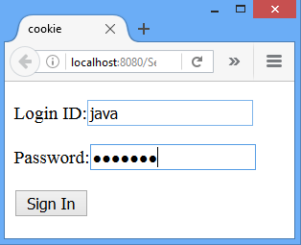
Session Management: Cookies
Cookie.html
Cookie1.java
Add Cookie
Cookie3.java
Retrieve All Cookies
Cookie2.java
Retrieve Cookie
Add Another Cookie

Slide 90
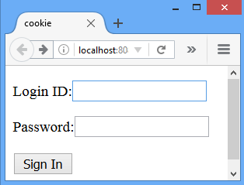
Session Management: Cookies
cookie.html
1
2
3
4
5
6
7
8
9
10
11
12
<html>
<head>
<title>cookie</title>
</head>
<body>
<form action="/Session/Cookie1" >
<p>Login ID:<input type="text" name="login"></p>
<p>Password:<input type="password" name="pwd"></p>
<p><input type="submit" value="Sign In"></p>
</form>
</body>
</html>

Slide 91
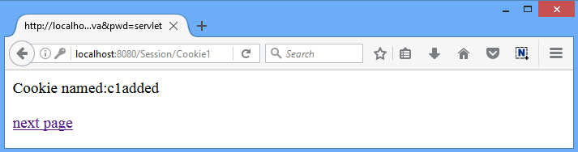
Session Management: Cookies
cookie1.java
1
2
3
4
5
6
7
8
9
10
11
12
13
14
15
16
17
public class Cookie1 extends HttpServlet
{ public void doGet(HttpServletRequest request, HttpServletResponse response)
throws ServletException,IOException
{ response.setContentType("text/html");
PrintWriter out=response.getWriter();
String login=request.getParameter("login");
String pwd=request.getParameter("pwd");
if(login.equals("java") && pwd.equals("servlet"))
{
Cookie c = new Cookie("c1",login);//create cookie
response.addCookie(c);//adds cookie with response
out.println("Cookie named:"+c.getName()+" added");
String path="/Session/Cookie2";
out.println("<p><a href="+path+">next page</a></p>");
}
else { //Redirect page to cookie.html}
} }

Slide 92
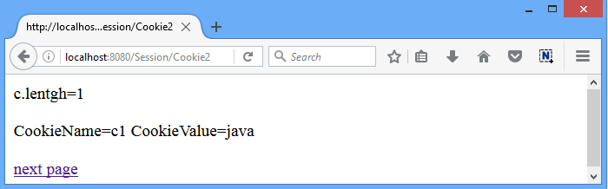
Session Management: Cookies
cookie2.java
1
2
3
4
5
6
7
8
9
10
11
12
13
14
15
16
17
18
public class Cookie2 extends HttpServlet
{ public void doGet(HttpServletRequest request, HttpServletResponse response) throws ServletException,IOException
{ response.setContentType("text/html");
PrintWriter out=response.getWriter();
Cookie c[]=request.getCookies();
out.println("c.length="+c.length);
for(int i=0;i<c.length;i++)
{ out.println("CookieName="+c[i].getName()+
"CookieValue="+c[i].getValue());
}
//to add another cookie
Cookie c1 = new Cookie("c2","054");
response.addCookie(c1);
String path="/Session/Cookie3";
out.println("<a href="+path+">next page</a>");
}
}

Slide 93
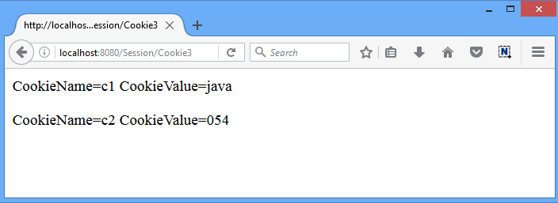
Session Management: Cookies
cookie3.java
1
2
3
4
5
6
7
8
9
10
11
12
13
14
15
public class Cookie3 extends HttpServlet
{ public void doGet(HttpServletRequest request, HttpServletResponse response)
throws ServletException,IOException
{ response.setContentType("text/html");
PrintWriter out=response.getWriter();
Cookie c[]=request.getCookies();
for(int i=0;i<c.length;i++)
{ out.println("<p>");
out.println("CookieName="+c[i].getName()+
"CookieValue="+c[i].getValue());
out.println("</p>");
}
}
}

Slide 94
Session Management: Cookies
Advantage of Cookies
Simplest technique of maintaining the state.
Cookies are maintained at client side.
Disadvantage of Cookies
It will not work if cookie is disabled from the browser.
Only textual information can be set in Cookie object.

Slide 95
Session Management : HttpSession
Apart from the above mentioned three ways, servlet provides HttpSession Interface which provides a way to identify a user across more than one page request
The container creates a session id for each user.
The container uses this id to identify the particular user.
An object of HttpSession can be used to perform two tasks:
Bind objects
View and manipulate information about a session, such as the session identifier, creation time, and last accessed time.

Slide 96
Session Management : HttpSession
Server
Web Container
Client1
Request
id=054
Session1
id= 054
Servlet
Session2
id= 055
Client2
Request
id=055
Working of HttpSession

Slide 97
Session Management :HttpSession
Package: javax.servlet.http.HttpSession
The servlet container uses this interface to create a session between an HTTP client and an HTTP server.
In this technique create a session object at server side for each client.
Session is available until the session time out, until the client log out.
The default session time is 30 minutes and can configure explicit session time in web.xml file.
The HttpServletRequest interface provides two methods to get the object of HttpSession
HttpSession getSession() | Returns the current session associated with this request, or if the request does not have a session, creates one.
HttpSession getSession(boolean create) | Returns the current HttpSession associated with this request or, if there is no current session and create is true then it will returns a new session.

Slide 98
Session Management : HttpSession
String getId() | Returns a string containing the unique identifier value.
long getCreationTime() | Returns the time when this session was created, measured in milliseconds.
long getLastAccessedTime() | Returns the last time the client sent a request associated with this session, as the number of milliseconds.
void invalidate() | Invalidates this session then unbinds any objects bound to it.

Slide 99
Session Management : HttpSession
How to create the session?
1
2
HttpSession hs=request.getSession();
hs.setAttribute("s_id", "diet054");
How to retrieve a session?
1
2
HttpSession hs=request.getSession(false);
String n=(String)hs.getAttribute("s_id");
How to invalidate a session?
1
hs.invalidate();

Slide 100
Session Management : HttpSession
Httpsession.html
[Login page]
HSession1.java
[Create Session]
HSession2.java
[Retrieve Session]
HSession4.java
[Logout]

Slide 101
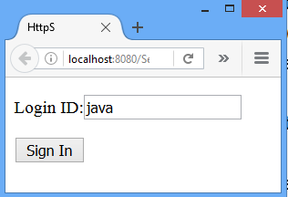
Session Management : HttpSession
Httpsession.html
1
2
3
4
5
6
7
8
9
10
11
12
<html>
<head>
<title>HttpSession</title>
</head>
<body>
<form action="/Session/HSession1" method="Get">
<p>Login ID:<input type="text" name="login"></p>
<p><input type="submit" value="Sign In"></p>
</form>
</body>
</html>

Slide 102
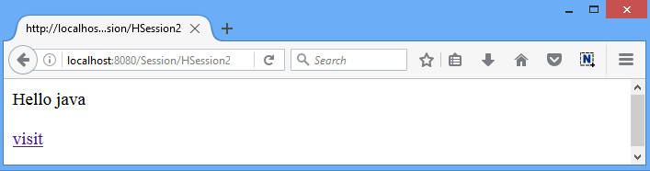
Session Management : HttpSession
HSession1.java
1
2
3
4
5
6
7
8
9
10
11
12
13
14
15
16
response.setContentType("text/html");
PrintWriter out=response.getWriter();
RequestDispatcher rd;
String login=request.getParameter("login");
if(login.equals("java") )
{ HttpSession hs=request.getSession();
hs.setAttribute("s_id",login);//set HttpSession
out.println("Session Created");
out.print("<a href='HSession2'>Homepage</a>");
}
else
{ out.println("<p><h1>Incorrect Login Id/Password </h1></p>");
rd=request.getRequestDispatcher("/httpsession.html");
rd.include(request, response);
}

Slide 103
Session Management : HttpSession
HSession2.java
1
2
3
4
5
6
7
8
9
10
11
12
13
public class HSession2 extends HttpServlet
{ public void doGet(HttpServletRequest request, HttpServletResponse response)
throws ServletException,IOException
{
response.setContentType("text/html");
PrintWriter out=response.getWriter();
HttpSession hs=request.getSession(false);
String n=(String)hs.getAttribute("s_id");
out.print("Hello "+n);
out.print("<p><a hef='HSession3’>Logout</a></p>");
}
}

Slide 104
Session Management : HttpSession
HSession3.java
1
2
3
4
5
6
7
8
9
10
11
12
13
14
15
16
17
18
19
20
public class HSession3 extends HttpServlet
{ public void doGet(HttpServletRequest request, HttpServletResponse response)
throws ServletException,IOException
{
response.setContentType("text/html");
PrintWriter out=response.getWriter();
HttpSession hs=request.getSession(false);
hs.invalidate();// Session Invalidated
try
{
String n=(String)hs.getAttribute("s_id");
}
catch(Exception ne)
{
out.println("Session Invalidated");
}
out.println("<form action='/Session/httpsession.html'>");
out.println("<p><input type='submit’ value=‘Login'></p></form>");
}
}

Slide 105
Session Timeout
The session timeout in a web application can be configured in two ways
Timeout in the deployment descriptor (web.xml)
Timeout with setMaxInactiveInterval()
Timeout in the deployment descriptor (web.xml)
1
2
3
4
5
<web-app>
<session-config>
<session-timeout> 10 </session-timeout>
</session-config>
</web-app>
Here specified time is in minutes
Timeout with setMaxInactiveInterval()
1
2
HttpSession session = request.getSession();
session.setMaxInactiveInterval(10*60);
Here specified time is in seconds

Slide 106
Filter API
Web Container
Filter
request
Filter request
Servlet Program
Filter response
response
WebClient

Slide 107
Filter
Filter is used for pre-processing of requests and post-processing of responses.
Filters are configured in the deployment descriptor of a web application.
Usage of Filter
Recording all incoming requests
Logs the IP addresses of the computers from which the requests originate
Conversion
Data compression
Encryption and Decryption
Input validation etc.

Slide 108
Filter API
The javax.servlet package contains the three interfaces of Filter API.
Filter
FilterChain
FilterConfig

Slide 109
Filter Interface
For creating any filter, you must implement the Filter interface.
Filter interface provides the life cycle methods for a filter.
Method
void init(FilterConfig config) | init() method is invoked only once. It is used to initialize the filter.
void doFilter (HttpServletRequest request, HttpServletResponse response, FilterChain chain) | doFilter() method is invoked every time when user request to any resource, to which the filter is mapped.It is used to perform filtering tasks.
void destroy() | This is invoked only once when filter is taken out of the service.

Slide 110
Filter Interface
Methods
1
2
3
4
5
6
7
8
9
10
public void init(FilterConfig config) throws ServletException {…}
public void doFilter(ServletRequest req, ServletResponse resp, FilterChain chain)
throws IOException,ServletException
{
//filter logic…
}
public void destroy() {…}

Slide 111
FilterChain interface
The object of FilterChain is responsible to invoke the next filter or resource in the chain.
This object is passed in the doFilter method of Filter interface.
The FilterChain interface contains only one method:
void doFilter (HttpServletRequest request, HttpServletResponse response) | It passes the control to the next filter or resource.
Example
1
2
FilterChain chain;
chain.doFilter(req, resp);//send request to next resource

Slide 112
Filter Example
Web Container
Filter1.java
FilteredServlet.java
request
Filter request
Servlet Program
Filter response
response
WebClient

Slide 113
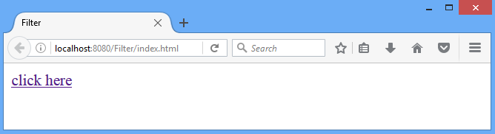
Filter Example: index.html
index.html
1
2
3
4
5
6
7
8
9
<html>
<head>
<title>Filter</title>
</head>
<body>
<a href="FilteredServlet">click here</a>
</body>
</html>

Slide 114
Filter Example
Web.xml
1
2
3
4
5
6
7
8
9
10
11
12
13
14
15
16
17
18
<web-app>
<servlet>
<servlet-name>FilteredServlet</servlet-name>
<servlet-class>FilteredServlet</servlet-class>
</servlet>
<servlet-mapping>
<servlet-name>FilteredServlet</servlet-name>
<url-pattern>/FilteredServlet</url-pattern>
</servlet-mapping>
<filter>
<filter-name>f1</filter-name>
<filter-class>Filter1</filter-class>
</filter>
<filter-mapping>
<filter-name>f1</filter-name>
<url-pattern>/FilteredServlet</url-pattern>
</filter-mapping>

Slide 115
Filter Example: Filter1.java
Filter1.java
1
2
3
4
5
6
7
8
9
10
11
12
13
14
public class Filter1 implements Filter
{
public void init(FilterConfig arg0) throws ServletException {//overridden init() method}
public void doFilter(ServletRequest req, ServletResponse resp,FilterChain chain) throws IOException, ServletException
{
PrintWriter out=resp.getWriter();
out.print("filter is invoked before");//exe. with request
chain.doFilter(req, resp);//send request to nextresource
out.print("filter is invoked after");//exe. with response
}
public void destroy() {//overridden destroy() method}
}

Slide 116
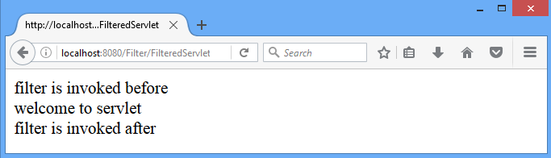
Filter Example: FilteredServlet.java
FilterServlet.java
1
2
3
4
5
6
7
8
9
10
11
12
13
14
import java.io.IOException;
import java.io.PrintWriter;
import javax.servlet.*;
import javax.servlet.http.*;
public class FilteredServlet extends HttpServlet
{
public void doGet(HttpServletRequest request, HttpServletResponse response)
throws ServletException, IOException
{
response.setContentType("text/html");
PrintWriter out = response.getWriter();
out.println("<br>welcome to servlet<br>");
}
}
Filter1.java [executed with request]
FilteredServlet.java [Servlet code]
Filter1.java [executed with response]

Slide 117
Filter Example-2
Web Container
Filter1.java
Filter2.java
FilteredServlet.java
Servlet Program
WebClient
Authenticate User
Check config parameter

Slide 118
Filter Example-2
index.html
1
2
3
4
5
6
7
8
9
10
11
12
<html>
<head>
<title>filter</title>
</head>
<body>
<form action="/Filter/FilteredServlet" >
<p>Login ID:<input type="text" name="login"></p>
<p>Password:<input type="password" name="pwd"></p>
<p><input type="submit" value="Sign In"></p>
</form>
</body>
</html>

Slide 119
Filter Example-2
Web.xml
Web.xml
1
2
3
4
5
6
7
8
9
10
11
12
13
14
15
16
17
18
<web-app>
<servlet>
<servlet-name>FilteredServlet</servlet-name>
<servlet-class>FilteredServlet</servlet-class>
</servlet>
<servlet-mapping>
<servlet-name>FilteredServlet</servlet-name>
<url-pattern>/FilteredServlet</url-pattern>
</servlet-mapping>
<filter>
<filter-name>f1</filter-name>
<filter-class>Filter1</filter-class>
</filter>
<filter-mapping>
<filter-name>f1</filter-name>
<url-pattern>/FilteredServlet</url-pattern>
</filter-mapping>
19
20
21
22
23
24
25
26
27
28
29
30
31
<filter>
<filter-name>f2</filter-name>
<filter-class>Filter2</filter-class>
<init-param>
<param-name>permit</param-name>
<param-value>yes</param-value>
</init-param>
</filter>
<filter-mapping>
<filter-name>f2</filter-name>
<url-pattern>/FilteredServlet</url-pattern>
</filter-mapping>
</web-app>

Slide 120
Filter Example-2
Filter1.java
1
2
3
4
5
6
7
8
9
10
11
12
13
14
15
16
17
18
19
20
21
public class Filter1 implements Filter{
public void init(FilterConfig config) {}
public void doFilter(ServletRequest req, ServletResponse resp, FilterChain chain)
throws IOException, ServletException
{
PrintWriter out=resp.getWriter();
out.print("<p>filter1 is invoked before</p>");
if(req.getParameter("login").equals("java") && req.getParameter("pwd").equals("servlet"))
{
chain.doFilter(req, resp);//send request to next resource
}//if
else
{
out.print("<p>invalid login/password</p>");
}//else
out.print("<p>filter1 is invoked after</p>");
}
public void destroy() {}
}

Slide 121
Filter Example-2
Filter1.java
1
2
3
4
5
6
7
8
9
10
11
12
13
14
15
16
17
18
19
20
public class Filter2 implements Filter{
String permission;
public void init(FilterConfig config) throws ServletException
{ permission=config.getInitParameter("permit");
}
public void doFilter(ServletRequest req, ServletResponse resp,FilterChain chain) throws IOException, ServletException
{ PrintWriter out=resp.getWriter();
out.print("<p>filter2 is invoked before</p>");
if(permission.equals("yes"))
{ chain.doFilter(req, resp);}//if
else
{
out.println("Permission Denied");
}//else
out.print("<p>filter2 is invoked after</p>");
}
public void destroy() {}}

Slide 122
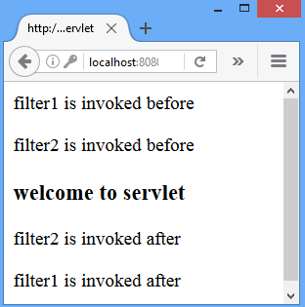
Filter Example-2
FilteredServlet.java
1
2
3
4
5
6
7
8
9
10
public class FilteredServlet extends HttpServlet {
public void doGet(HttpServletRequest request, HttpServletResponse response)
throws ServletException, IOException
{
response.setContentType("text/html");
PrintWriter out = response.getWriter();
out.println("<p><h3>welcome to servlet</h3></p>");
}
}

Slide 123
Filter
Advantage of Filter
Filter is pluggable.
One filter don't have dependency onto another resource.
Less Maintenance Cost
The servlet filter is pluggable, i.e. its entry is defined in the web.xml file, if we remove the entry of filter from the web.xml file, filter will be removed automatically and we don't need to change the servlet.
So maintenance cost will be less.

Slide 124
Servlet with JDBC
ServletWithJDBC.java
1
2
3
4
5
6
7
8
9
10
11
12
13
14
15
16
17
18
19
20
21
22
23
24
25
import java.io.*;
import java.sql.*;
import javax.servlet.*;
import javax.servlet.http.*;
public class JDBCServlet extends HttpServlet
{
public void doGet(HttpServletRequest request, HttpServletResponse response)
throws ServletException,IOException
{ response.setContentType("text/html");
PrintWriter out=response.getWriter();
//Program continued in next slide ...
try{
Class.forName("com.mysql.jdbc.Driver");
Connection con=DriverManager.getConnection ("jdbc:mysql://localhost:3306/ajava","root","");
Statement st=con.createStatement();
ResultSet rs=st.executeQuery("select * from cxcy");
while(rs.next())
{ out.println("<p>"+rs.getInt(1));
out.println(rs.getString(2));
out.println(rs.getString(3)+"</p>");
}
}catch(Exception e)
{out.println("<p>inside exception"+e.toString()+"</p>");}
}//doGet()
}//Class

